Slide 1
Theory of Equations

Slide 2
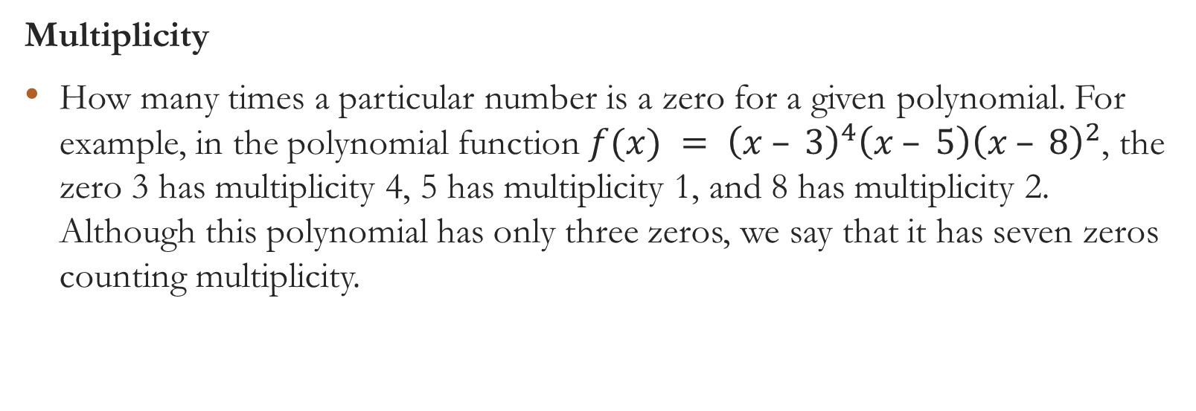
www.mathwords.com gives the following definition:
Multiplicity
How many times a particular number is a zero for a given polynomial. For example, in the polynomial function $f(x) = {\left(x – 3\right)}^{4}\left(x – 5\right){\left(x – 8\right)}^{2}$, the zero 3 has multiplicity 4, 5 has multiplicity 1, and 8 has multiplicity 2. Although this polynomial has only three zeros, we say that it has seven zeros counting multiplicity.

Slide 3
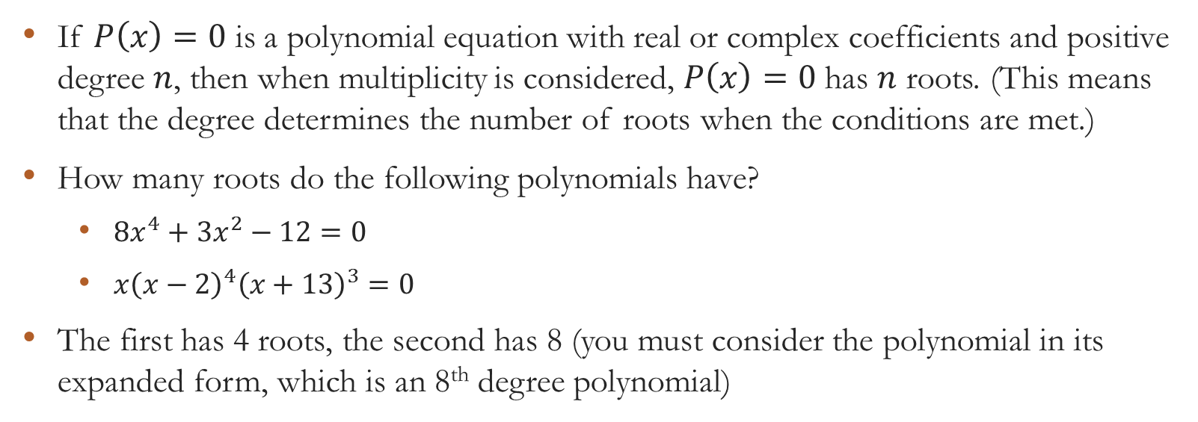
n-Root Theorem
If $P\left(x\right)=0$ is a polynomial equation with real or complex coefficients and positive degree $n$, then when multiplicity is considered, $P\left(x\right)=0$ has $n$ roots. (This means that the degree determines the number of roots when the conditions are met.)
How many roots do the following polynomials have?
$8x^{4}+3x^{2}−12=0$
$x{\left(x−2\right)}^{4}{\left(x+13\right)}^{3}=0$
The first has 4 roots, the second has 8 (you must consider the polynomial in its expanded form, which is an 8th degree polynomial)

Slide 4
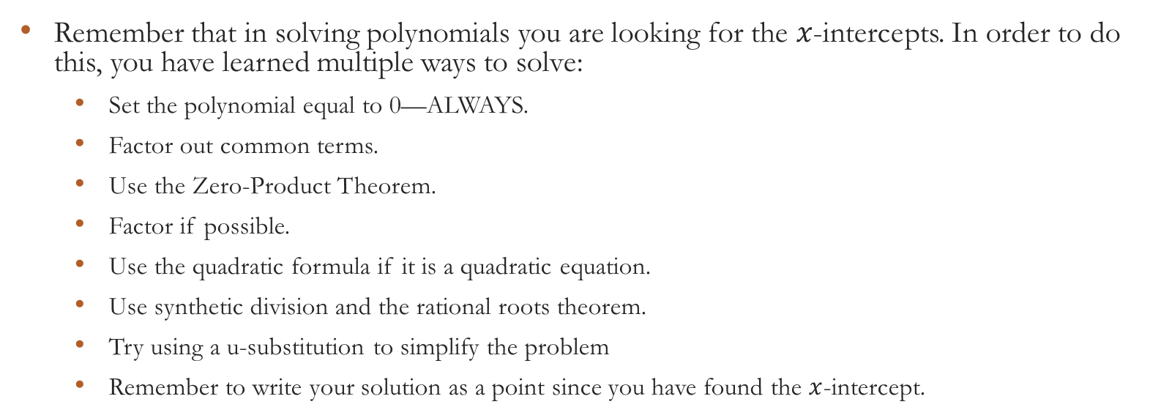
Reminders
Remember that in solving polynomials you are looking for the $x$-intercepts. In order to do this, you have learned multiple ways to solve:
Set the polynomial equal to 0—ALWAYS.
Factor out common terms.
Use the Zero-Product Theorem.
Factor if possible.
Use the quadratic formula if it is a quadratic equation.
Use synthetic division and the rational roots theorem.
Try using a u-substitution to simplify the problem
Remember to write your solution as a point since you have found the $x$-intercept.

Slide 5

Solve the following polynomial equations:
$x^{3}−2x^{2}−5x+6=0$
$6x^{5}=−24x^{3}$
${\left(x−3\right)}^{2}{\left(x+14\right)}^{5}=0$
$2x^{3}−5x^{2}−6x=−4$
$x^{3}+4x^{2}=−4x−3$

Slide 6
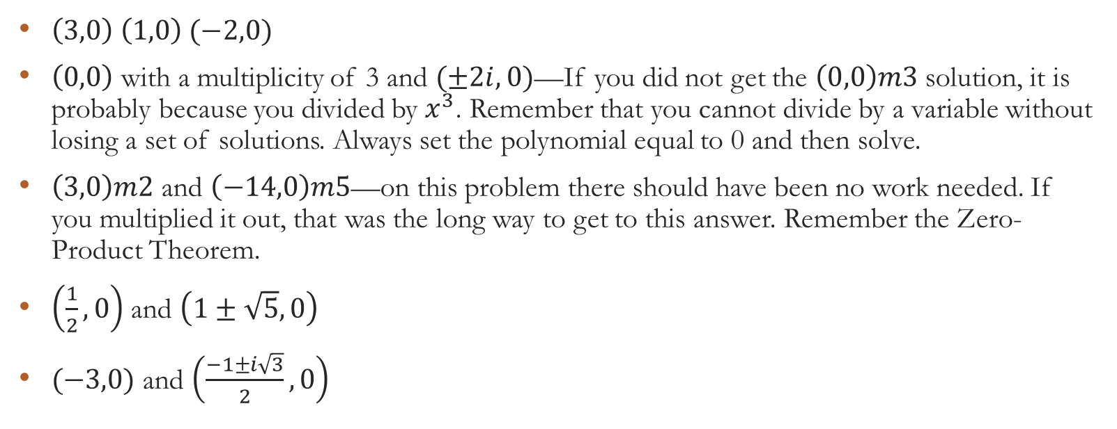
Solutions
$\left(3,0\right) \left(1,0\right) (−2,0)$
$\left(0,0\right)$ with a multiplicity of 3 and $(±2i,0)$—If you did not get the $\left(0,0\right)m3$ solution, it is probably because you divided by $x^{3}$. Remember that you cannot divide by a variable without losing a set of solutions. Always set the polynomial equal to 0 and then solve.
$\left(3,0\right)m2$ and $\left(−14,0\right)m5$—on this problem there should have been no work needed. If you multiplied it out, that was the long way to get to this answer. Remember the Zero-Product Theorem.
$\left(\frac{1}{2},0\right)$ and $\left(1±\sqrt{5},0\right)$
$(−3,0)$ and $\left(\frac{−1±i\sqrt{3}}{2},0\right)$

Slide 7
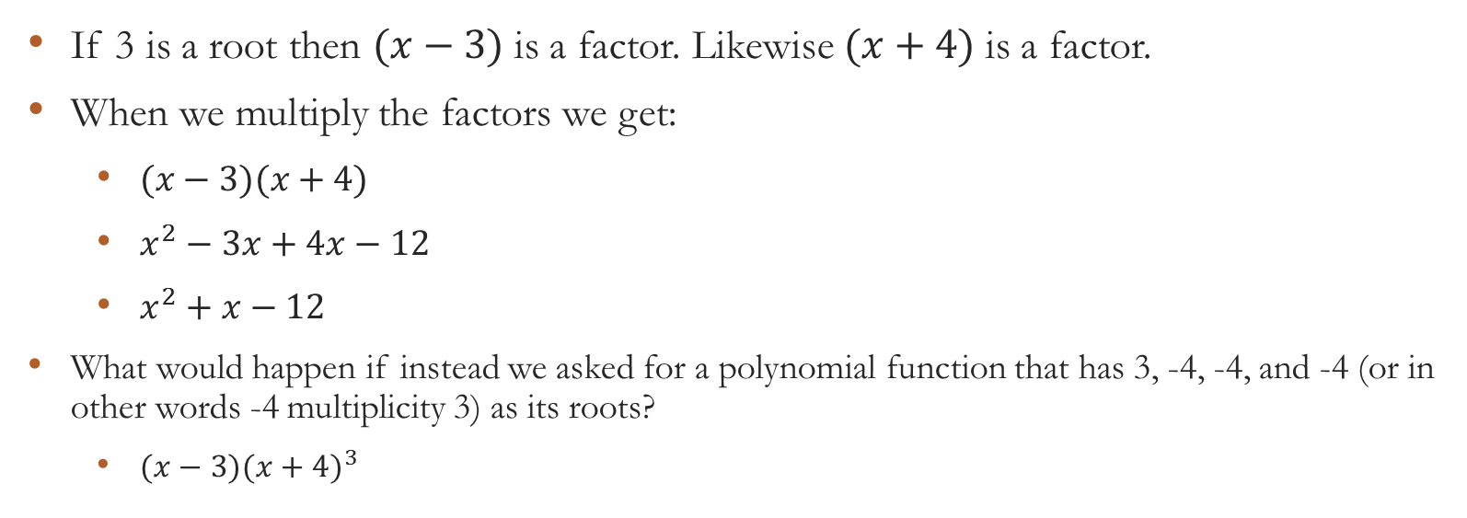
So let’s do an example or two: Find a polynomial that has 3 and -4 as its roots.
If 3 is a root then $(x−3)$is a factor. Likewise $(x+4)$is a factor.
When we multiply the factors we get:
$(x−3)(x+4)$
$x^{2}−3x+4x−12$
$x^{2}+x−12$
What would happen if instead we asked for a polynomial function that has 3, -4, -4, and -4 (or in other words -4 multiplicity 3) as its roots?
$(x−3)({x+4)}^{3}$

Slide 8
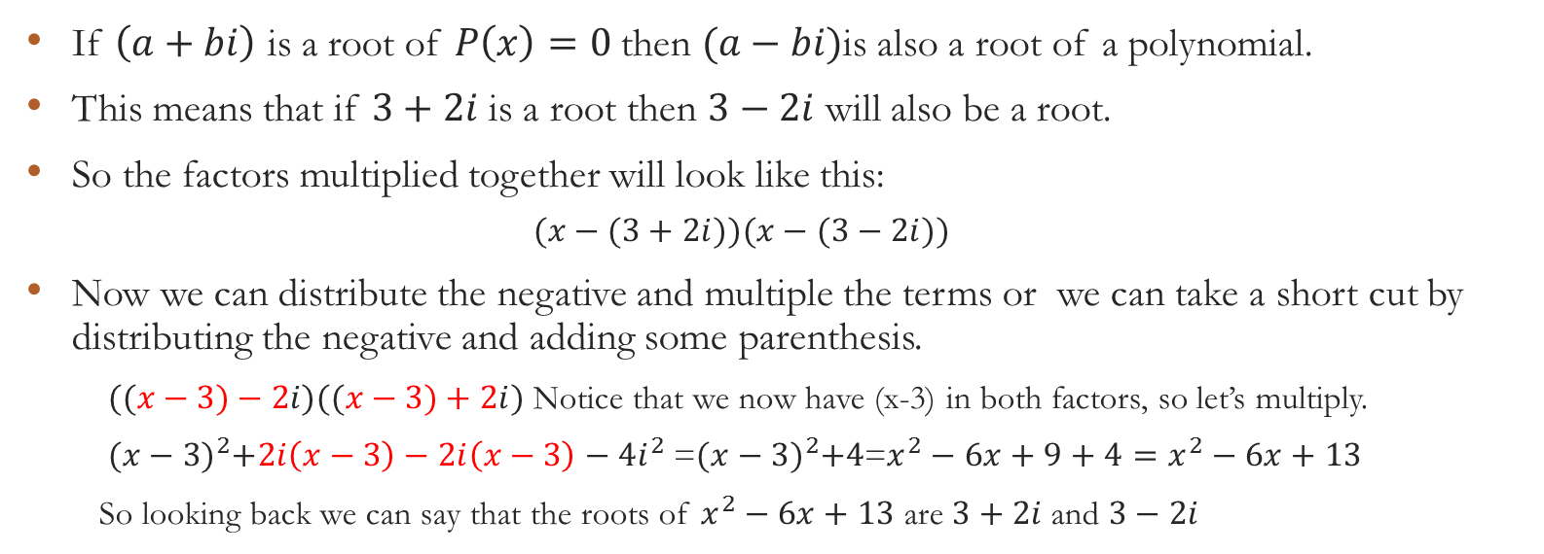
Complex roots come in pairs
If $\left(a+bi\right)$ is a root of $P\left(x\right)=0$then $(a−bi)$is also a root of a polynomial.
This means that if $3+2i$is a root then $3−2i$ will also be a root.
So the factors multiplied together will look like this:
$$(x−(3+2i))(x−(3−2i))$$
Now we can distribute the negative and multiple the terms or we can take a short cut by distributing the negative and adding some parenthesis.
$((x−3)−2i)((x−3)+2i)$ Notice that we now have (x-3) in both factors, so let’s multiply.
${(x−3)}^{2}+2i\left(x−3\right)−2i\left(x−3\right)−4i^{2}$=${(x−3)}^{2}+4$=$x^{2}−6x+9+4=x^{2}−6x+13$
So looking back we can say that the roots of $x^{2}−6x+13$ are $3+2i$and $3−2i$

